Slide 1
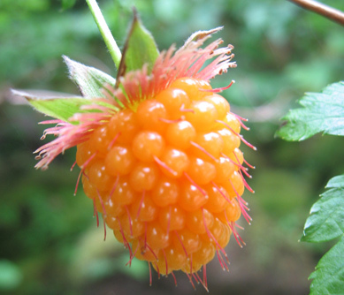
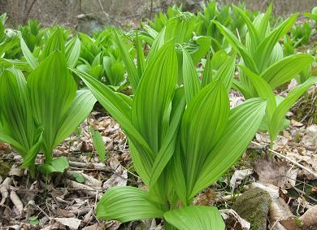
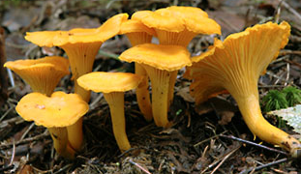
Guide to Aboriginal Forest Resources
January 11, 2017
Kai Sonnenburg, RPF

Slide 2
commitments under the GBRO:
Objective: Identify AFRs through field assessments and First Nation Engagement.
Objective: Maintain or enhance AFRs in sufficient quantity and manner to support First Nations’ present and future stewardship and use of those resources.

Slide 3
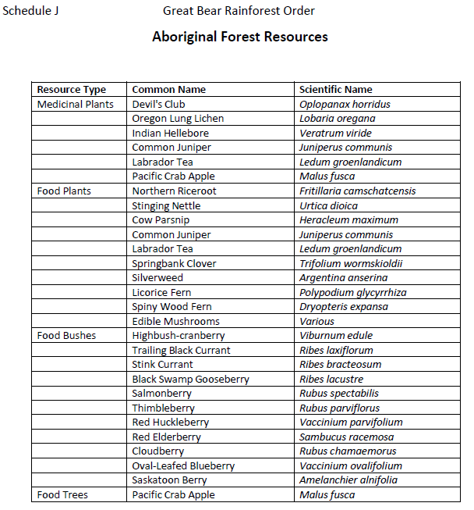
definition of Aboriginal Forest Resources:
Or other forest plant resource identified by First Nations that is utilized for food or for social, medicinal or ceremonial purposes.

Slide 4
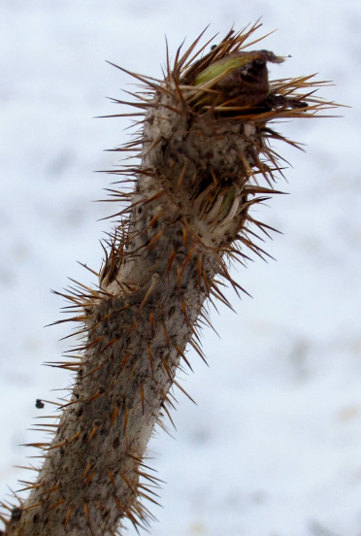
Devil’s Club Oploplanax horridus
Grows in moist, nutrient rich sites (e.g. stream draws, avalanche chutes).
Common throughout the GBRO plan area.
Armed with clubs that like to fester in your skin.
1 to 3 m tall stems.
Large (30 to 40 cm) maple-shaped leaves.

Slide 5
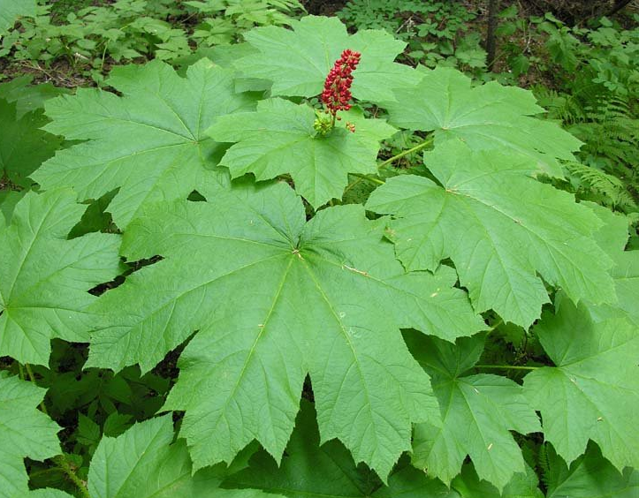
Devil’s Club Oploplanax horridus
Red berries are toxic for us but bears eat them.
Most widely used medicinal plant by Coastal First Nations.
Inner green bark of roots was the major part used for medicine.

Slide 6
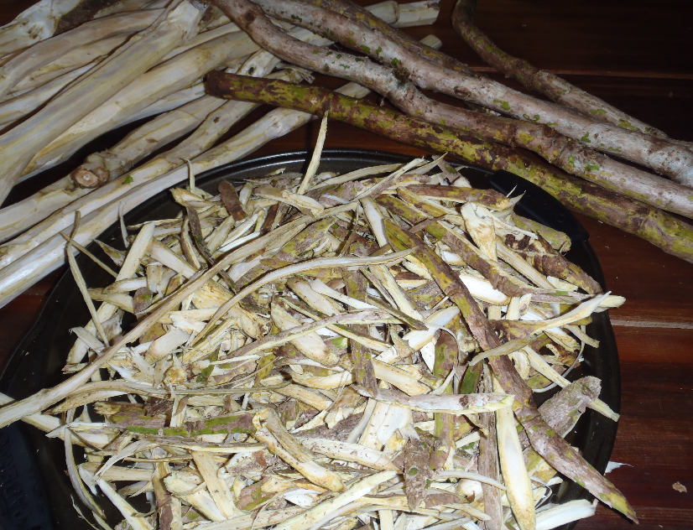
Devil’s Club sticks were/are used as protective charms, it is believed they can guard against evil spirits.
Charcoal was mixed with bear grease and used as ceremonial face-paint and tattoo ink.
Processed into Beauty products incl. deodorant, perfume and talc.

Slide 7
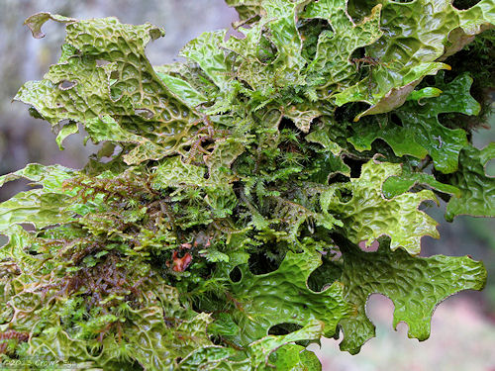
Oregon Lung Lichen Lobaria oregana
Large loosely-attached leafy lichen.
Yellowish green surface.
Hairy brownish underside with yellow naked patches.

Slide 8
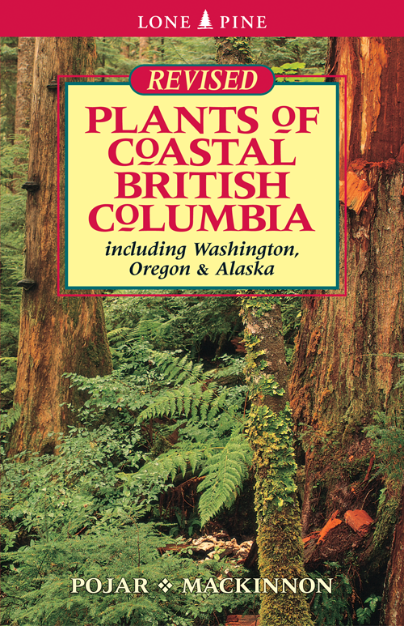
Oregon Lung Lichen
Broad (2-4 cm) wide lobes.
Grows on trees in cool moist forests.
Common in the GBRO.
No visible reproductive bodies as L. pulmonaria which has wart-like outgrowths (isidia) and/or powdery warts (soredia).
Hesquiat people made cough medicine with it.

Slide 9
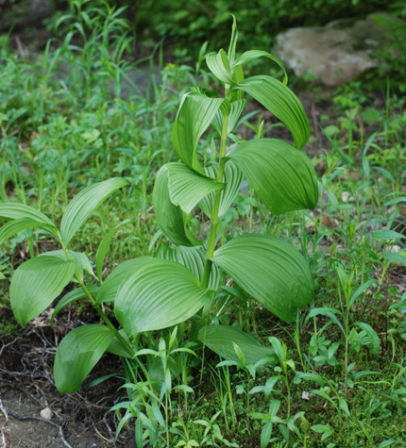
Indian Hellebore Veratrum viride
Violently poisonous!
Do not drink water from adjacent sources.
Used by practically all Coastal First Nations to treat various ailments.
Perennial plant sprouting from rhizome, usually in bunches.
Leaves have prominent ridges.

Slide 10
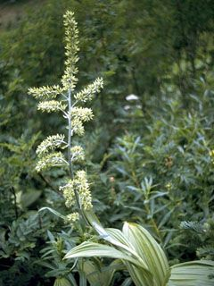
Indian Hellebore Veratrum viride
Occurs on moist to wet sites at all elevations (e.g. streambanks, bogs, alpine meadows etc.)
Small pale-green flowers star-shaped and growing in clusters.

Slide 11
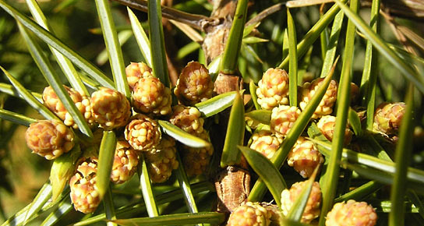
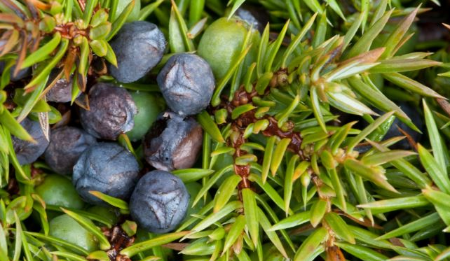
Juniper Juniperus communis
Dioecious shrub (one sex per plant).
Evergreen shrub usually < 1 m tall with stiff/prickly needles.
Small brown pollen cones (male).
Berry-like female cones which start green turning blue or purple in 2nd year when mature.

Slide 12
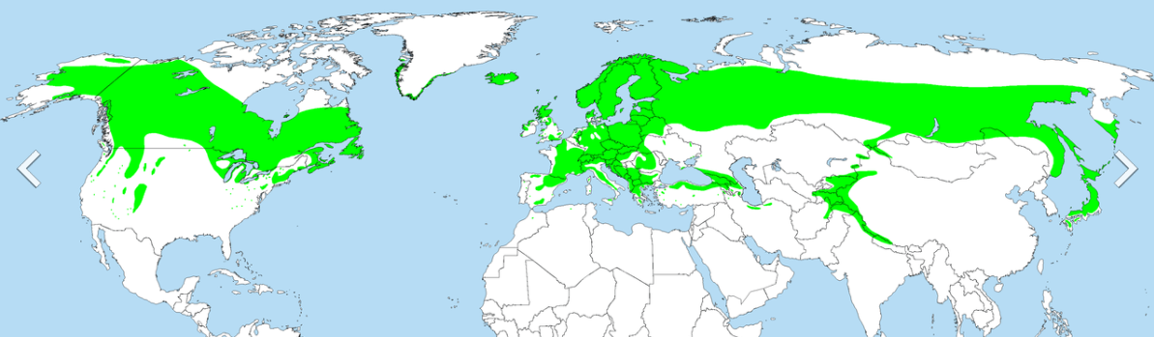
Juniper has the largest range of any woody plant.
Usually found on extreme sites (e.g. wetland bogs, alpine tundra, dry rocky sites etc.)
Used by Europeans to flavour meat, soup, stews, gin and other alcoholic beverages.
“Was considered an important medicine for interior peoples but was not widely used on the Northwest Coast.” Pojar & MacKinnon.

Slide 13
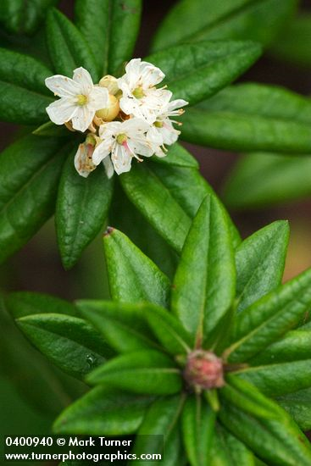
Labrador Tea Ledum groenlandicum
In Rhododendron Family.
Range almost as extensive as Common Juniper.
Aboriginal medicinal ingredient for cold and sore-throat remedies.
Grows on wet, nutrient-poor sites (e.g. bogs, alpine meadows).
Generally 0.5 to 1.5 m tall.
White flowers in clusters.

Slide 14
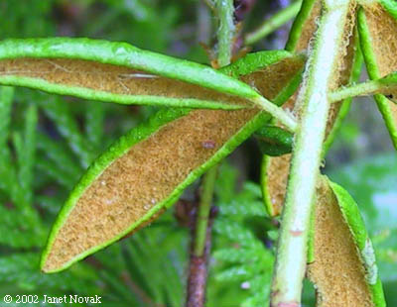
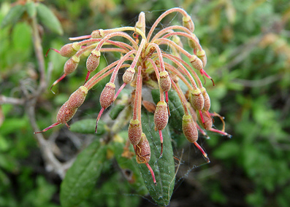
Labrador Tea Ledum groenlandicum
Long narrow leaves with curled margins and a leathery surface texture.
Underside of leaf has dense rusty hairs.
Other varieties of Ledum are toxic but their leaves are all naked.
Fruiting bodies are dry hairy capsules occurring in drooping clusters.

Slide 15
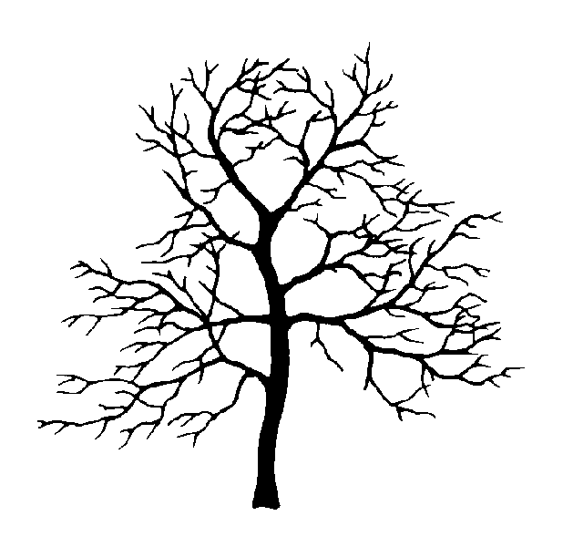
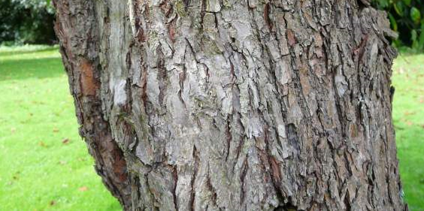
Pacific Crab Apple Malus fusca
Shrub or small tree up to 12 m tall – very bushy.
Armed with sharp spur-shoots.
Deeply fissured bark when mature.
Found on moist sites (swamps, stream banks, estuaries and upper beaches).

Slide 16
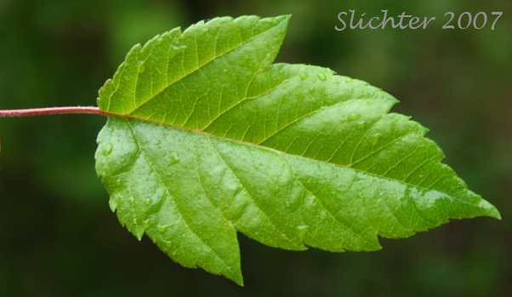
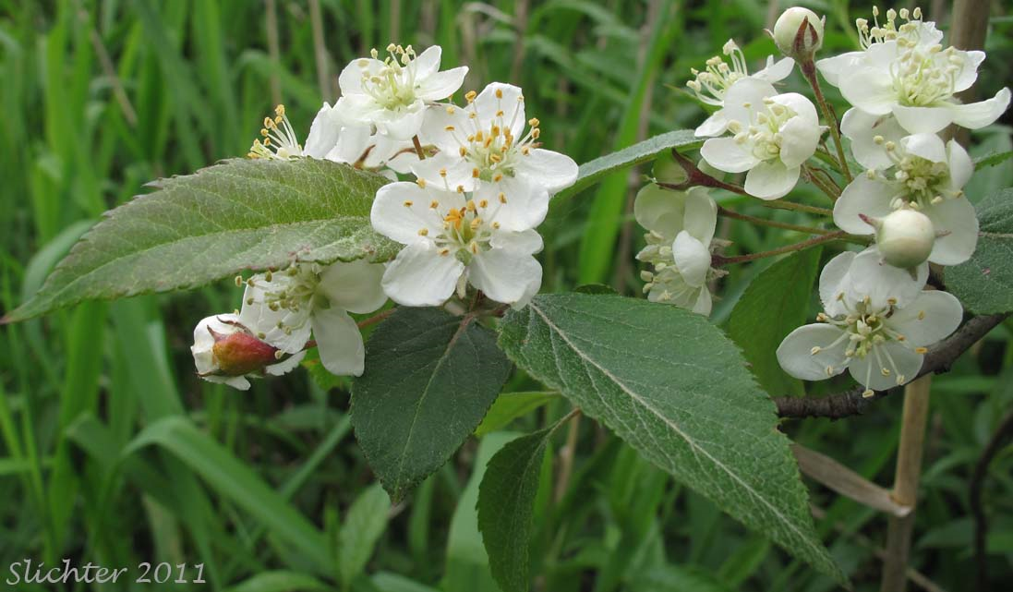
Pacific Crab Apple Malus fusca
Bark harvested Aboriginally for medicine. It can produce cyanide if processed improperly so extreme caution is necessary.
White to pink flowers each about 2 cm across but displayed in showy clusters.
Toothed leaves ~10 cm long.

Slide 17
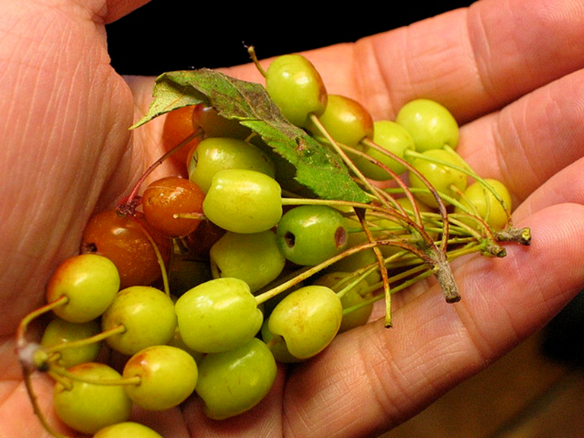
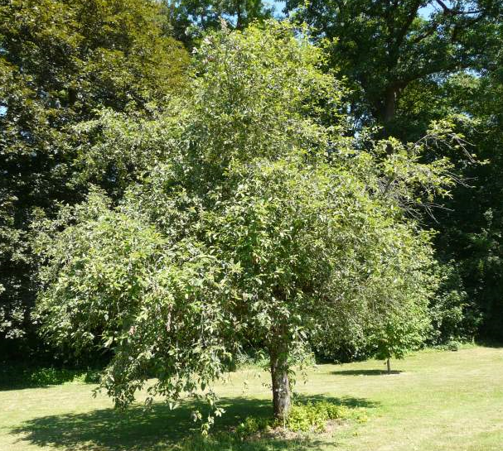
Apples!
Start green then ripen to yellow or red.
Tiny and oblong (1-2 cm long).
Very acidic and do not require further preservation.
Bitter to taste even when ripe but sweeten somewhat with age.
Important food source for all Coastal First Nations.

Slide 18
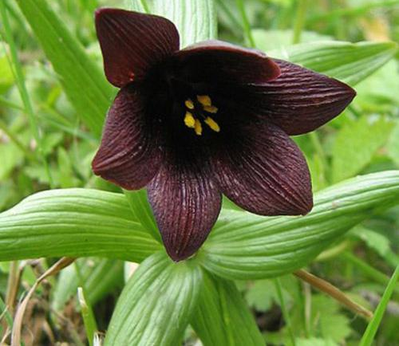
Northern Riceroot Fritillaria camschatcensis
Grow on moist to wet sites (e.g. stream banks, estuaries, swamps, alpine meadows).
Sturdy perennial up to 60 cm tall growing from a scaly bulb.
Flowers bronze to purple-brown, bell shaped with flaring mouth and foul odour.
Leaves up to 8 cm long are distributed in 3 main whorls of 5-10 leaves.

Slide 19
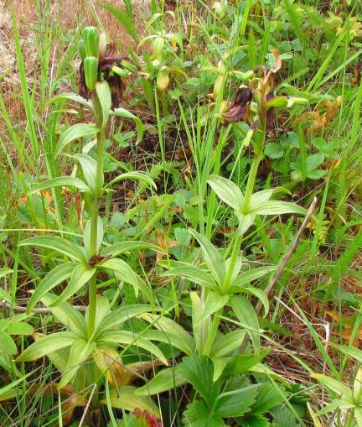
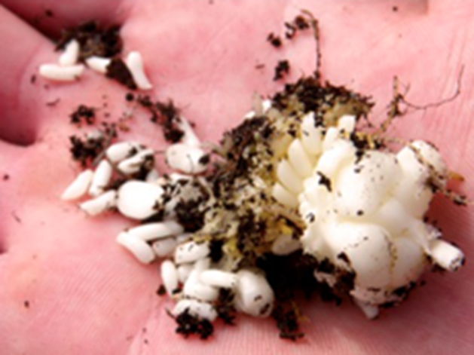
Northern Riceroot Fritillaria camschatcensis
Bulbs resemble tight clusters of rice.
Bulbs were a food staple for virtually all Coastal First Nations.

Slide 20
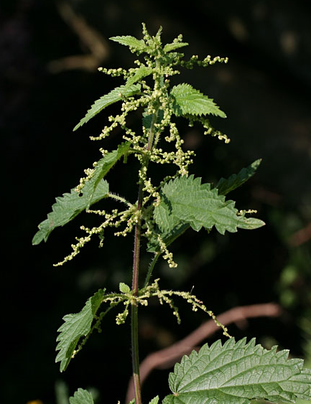
Stinging Nettle Urtica dioica
Perennial sprouting from rhizome.
Needs moist rich soil.
Likes disturbed areas (avalanche zone, roads, cutblocks middens).
Stands 1 to 3 m tall.
Leaves are 5 to 15 cm long with saw-toothed margins.
Tiny flowers (2-3 mm) arranged in dense drooping clusters.

Slide 21
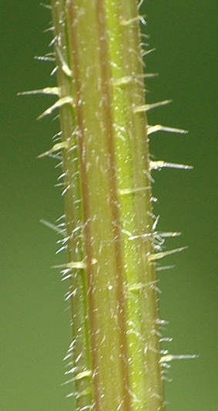
Stinging Nettle Urtica dioica
Leaves and stem have stinging hairs containing formic acid and histamine which causes irritation and rash.
Cooking or soaking removes the stinging chemicals from the plant.
Tastes like spinach, and is rich in vitamin A and C, iron, potassium, manganese, and calcium. Contains 25% protein by dry weight (very high for a leafy green vegetable).
Do not eat after it starts flowering, plant cellulose becomes indigestible and can cause urinary tract irritation.
Important source of rope/textile fibre.

Slide 22
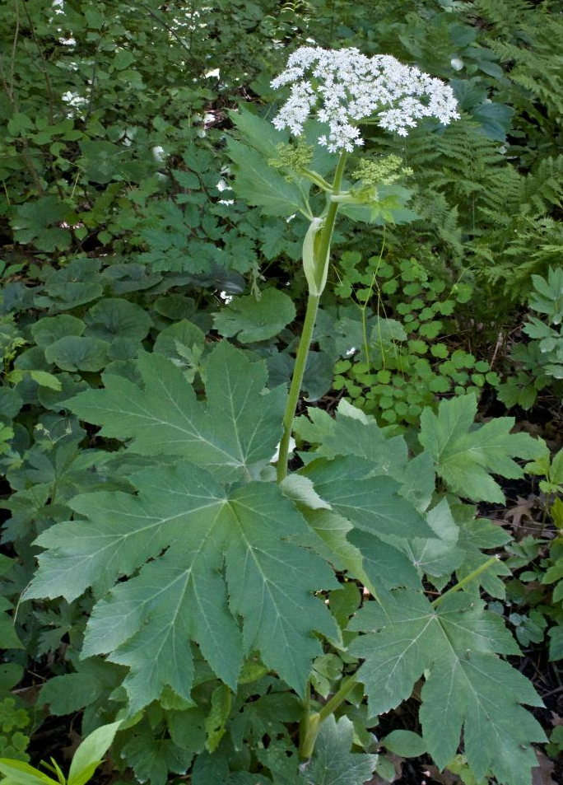
Cow Parsnip Heracleum maximum
a.k.a.… H. lanatum & H. sphondylium
Grows on moist open sites (e.g. stream banks, marshes, estuaries, avalanche tracks, roadsides).
Tall (1 to 3 m) and hairy perennial growing from stout taproot.
Strong pungent odour.
Leaves are large (up to 40 cm) and maple-like.

Slide 23
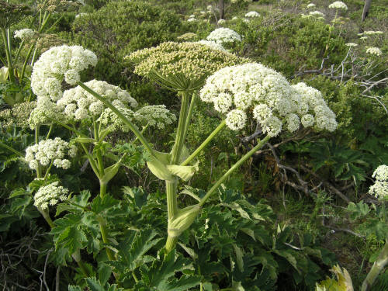
Cow Parsnip Heracleum maximum
In same family as Dill Carrot, and Hogweed (Apiaceae).
Distributed throughout temperate N. America.
Small white flowers in umbrella-like cluster at apex with up to 4 secondary umbels from side-shoots.
Young stalks and leaf stems were peeled and eaten raw by virtually all Coastal First Nations. They have a sweet and mild flavour despite the plant’s strong odour.

Slide 24
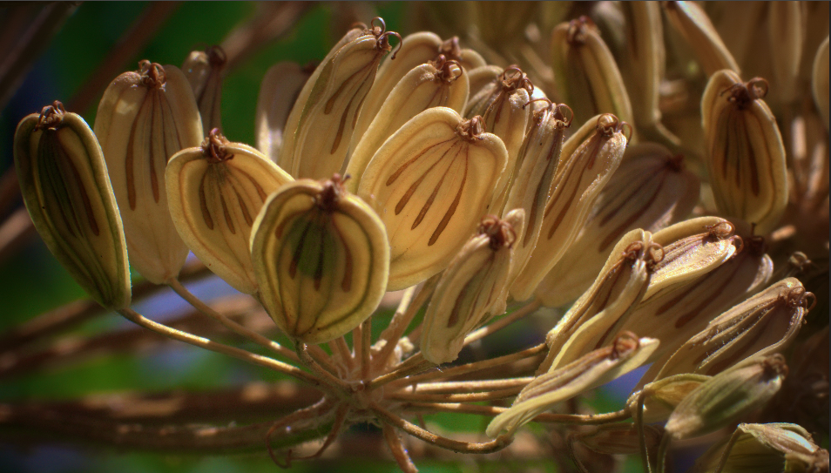
Cow Parsnip Heracleum maximum
Produces sunflower-like aromatic seeds with broad lateral wings. Seed pods are ~1 cm long.

Slide 25
Cow Parsnip (H. max) vs. Giant Hogweed (H. man)
H. maximum | H. mantegazzianum
Indigenous to N. America and distributed throughout its range | Invasive noxious weed typically in urban areas, cultivated land and/or roadways
1-3 m tall | 2-5 m tall
Leaves 10-40 cm long and wide | Leaves up to 1 m long
Green stem, can have purplish sections but no spots or blotches | Stem green with red or purple sections spotted or blotchy
A flower umbel can be up to 15 cm in diameter | A flower umbel measures 30 to 100 cm!
Umbels have 15 to 30 rays | Umbels have 50 or more rays

Slide 26
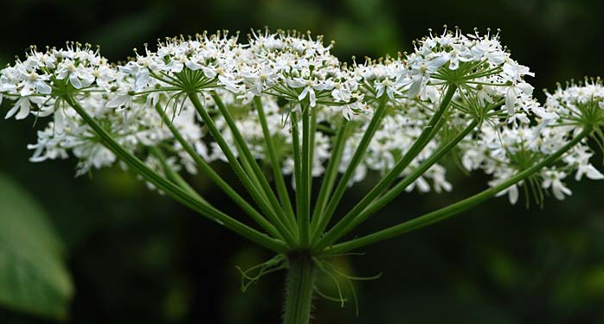
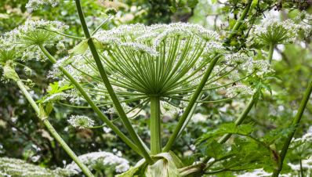
Cow Parsnip (H. max) vs. Giant Hogweed (H. man)
Less than 30 rays per umbel (Cow Parsnip)
More than 50 rays per umbel (Giant Hogweed)

Slide 27
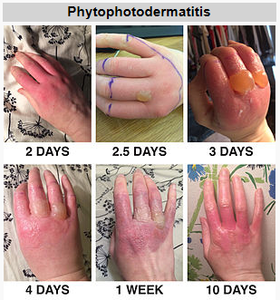
Cow Parsnip and Giant Hogweed
Contains furocoumarins which can cause phytophotodermatitis.
Reaction typically begins within 24 hours of exposure and peaks at 2-3 days.
Treatable but may result in permanent skin pigmentation (discolouring).

Slide 28
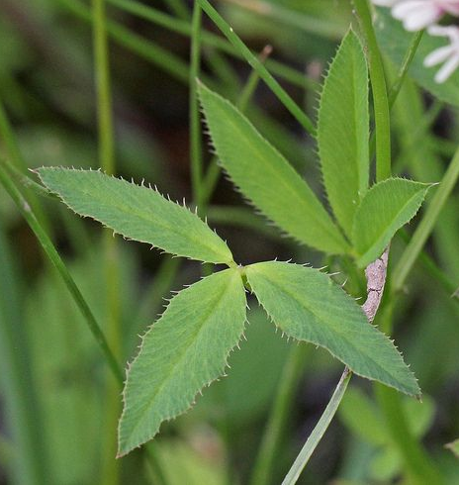

Springbank Clover Trifolium wormskioldii (or wormskjoldii)
Perennial herb with creeping rhizome.
Moist to wet open places from low to middle elevations (estuaries, swamps, stream banks).
Long pointed leaflets unlike other clovers.
Leaves compound in groups of 3 (unless you’re lucky enough to find one with 4).

Slide 29
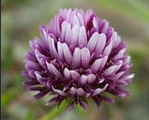
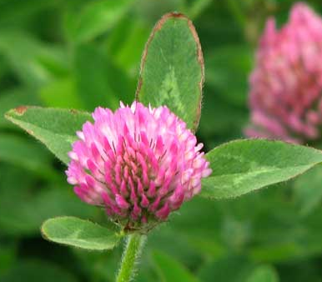
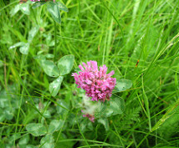
Springbank Clover Trifolium wormskioldii (or wormskjoldii)
Red to purple or pinky purple flowers often with white tips in dense round heads (indistinguishable from White Clover).
Long fleshy white rhizome was harvested in fall and eaten raw, steamed, or dried and stored for winter use.
The Kwakwaka'wakw cultivated them in family gardens along estuaries. Gardens were owned individually or by families and were passed from one generation to the next.

Slide 30
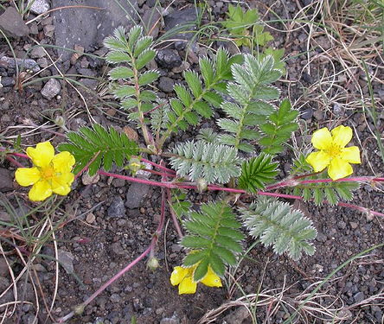
Silverweed Argentina anserina
Associated with same plant community as Springbank Clover (bogs, swamps estuaries etc).
Single yellow flower on leafless stalk.
Leaves are basal, pinnate and wooly (especially on the underside).
Propagates with runners in addition to seeds.

Slide 31
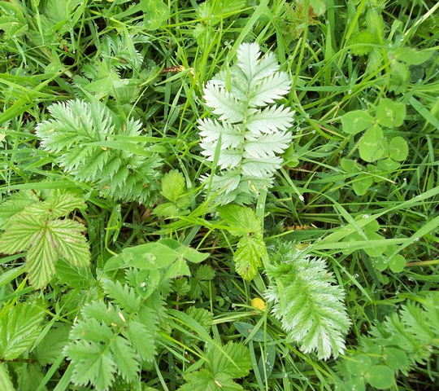
Silverweed Argentina anserina
Roots eaten by virtually all Coastal First Nations.
Has to be cooked to reduce bitterness.
Tastes like yams.
Also used medically by Kwakwaka'wakw: Roots were pressed and extracted juice was applied to inflamed eyes.

Slide 32
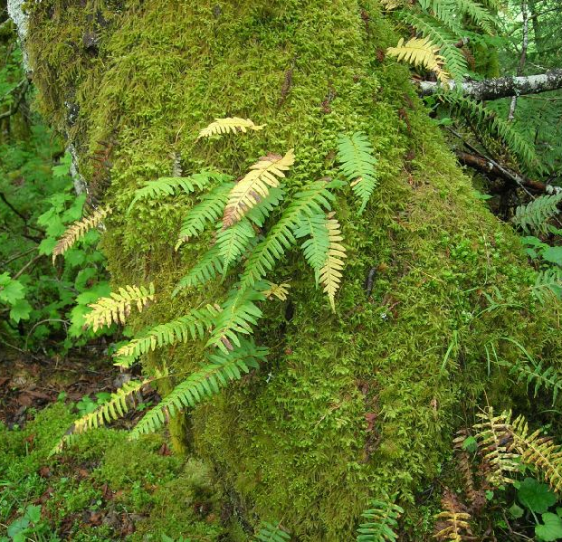
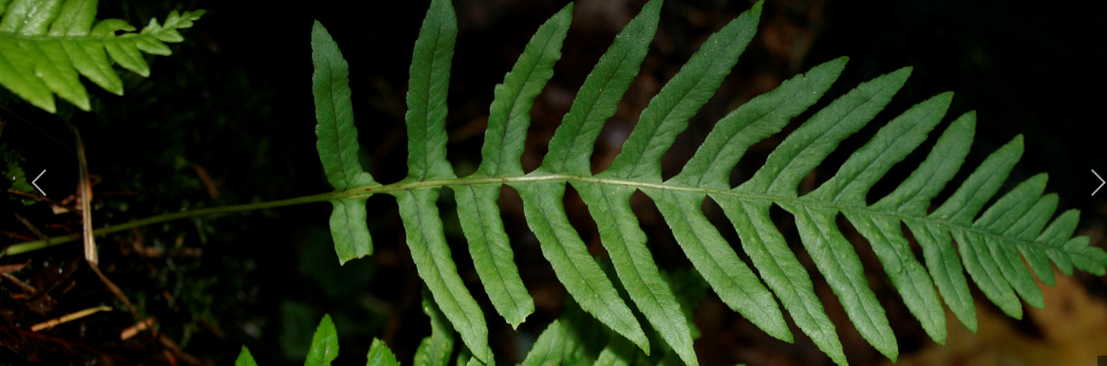
Licorice Fern Polypodium glycyrrhiza
Medium sized evergreen fern up to 70 cm tall.
Can grow on soil, rocks, or trees (usually deciduous).
Straw coloured stipes.
Leaflets longer than 3 cm and finely toothed at margins
Pinnate

Slide 33
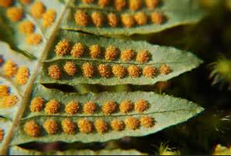
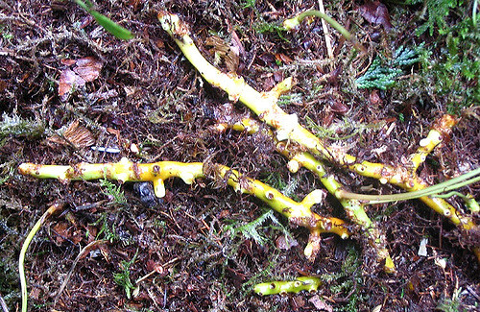
Licorice Fern Polypodium glycyrrhiza
Sori (spore cases) round, parallel and evenly spaced on either side of leaflet vein.
Rhizomes were Aboriginally consumed as a snack for its sweet licorice flavour.
Also used as medicine for colds and sore throat and mixed with bitter medicines as a sweetener.

Slide 34
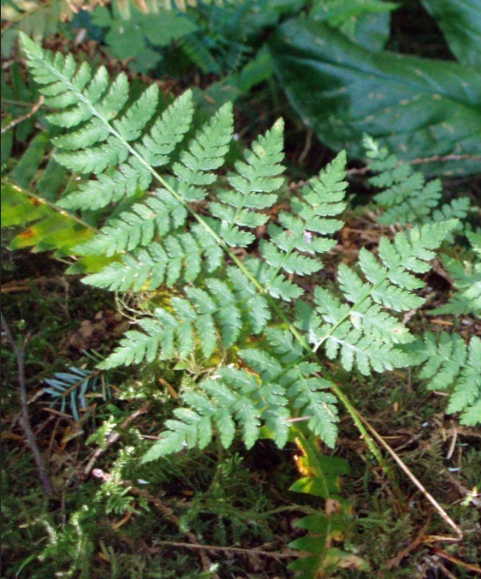
Spiny Wood Fern Dryopteris expansa
Prefers moist to very moist medium to rich sites.
Up to 1 m tall.
Usually in clusters.
Lowest leaf pair triangular and asymmetrical.
Rootstocks were an important starchy food.
Leaflet vein has spiny texture like cedar.

Slide 35
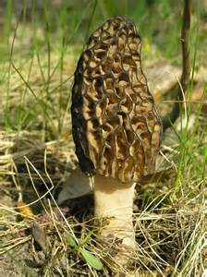
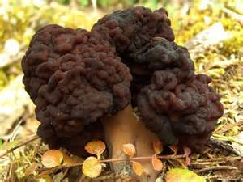
Edible Mushrooms (not defined in the GBRO)
Black Morel has honeycomb appearance with deep distinct and pronounced ridges.
False Morel is wavy, lobed and toxic (although usually not fatal when consumed).
Both emerge in spring.
Both grow in warm to hot disturbed areas like clearcuts and forest fires often beside each other.

Slide 36
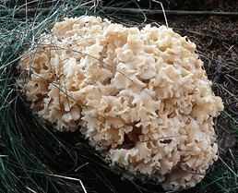
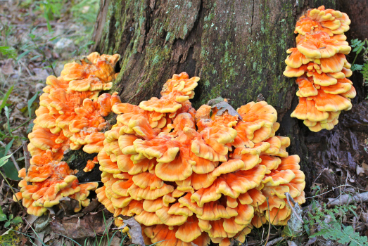
Edible Mushrooms (not defined in the GBRO)
Cauliflower Mushroom.
No poisonous look-alikes.
Up to 30 cm across.
No pores tubes spines or gills.
Appears in late summer or fall on ground or near base of conifers.
Chicken of the Woods (Yes, it tastes like chicken!).
Can be mildly toxic if grown on yew or cedar.
Grows on conifers in “shelves”.
Hen of the Woods is different.

Slide 37
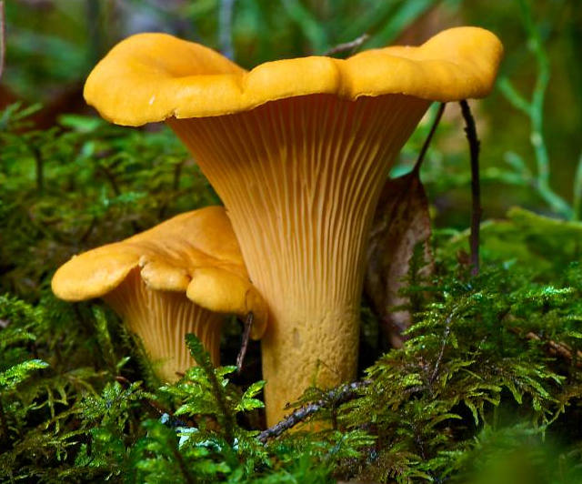
Golden Chanterelle
Funnel shaped with forked ridges under cap descending to stem (not true gills).
Grows on soil singularly or in groups but never on trees or logs.
Emerges in summer or fall.
Associated with Douglas Fir and Hemlock.
To harvest, cut at base with knife to prevent damage to mycelia.

Slide 38


King Bolete
Cap is up to 35cm wide, convex, reddish to yellowish brown, smooth but often uneven.
Underside of cap consists of pores, off-white to olive in age, with no pink tinge.
There are no deadly-poisonous boletes, though some varieties can cause nausea/vomiting. A bolete is safe if it does not bruise blue after being cut, is not red on the underside of the cap, and does not taste foul.
Appears in spring, summer and fall.

Slide 39


Scaly Hedgehog
Cap is up to 30cm wide, convex shape with depressed centre, brown with raised scales and dry texture.
Underside has brown spines descending onto stem.
Smooth light brown stem is thicker at the base.
Grows singly or as several in areas with conifers.
Appears in summer and fall.

Slide 40


Highbush-cranberry Viburnum edule
Grows in open areas on a variety of sites.
Up to 3.0 m tall.
Leaves have 3 lobes, toothed margins, and hairy undersides.
White flowers in small clusters.
Berries are 1 to 1.5 cm long, persistent, & contain a single seed.
Tart, juicy and acidic. No preservation req’d.

Slide 41

Trailing Black Currant Ribes laxiflorum
Trailing shrub growing under canopy and on open sites.
Flowers reddish purple, saucer shaped ascending to erect clusters.

Slide 42

Trailing Black Currant Ribes laxiflorum
Leaves maple-shaped 4 to 10 cm wide.
Berries purplish-black, waxy and hairy with a disagreeable odour and flavour.

Slide 43


Stink Currant Ribes bracteosum
Erect stems up to 3 m.
Distinct cat-pee or skunky odour.
Moist to wet nutrient rich sites (avalanche tracks, swamps, stream banks).
White flowers.
Leaves have to 5 to 7 lobes with toothed margins.
Blue/purple fruit with white bloom.
Can cause constipation if eaten in large quantities.

Slide 44


Black Swamp Gooseberry Ribes lacustre
The only armed currant in the coastal rainforest.
Grows on a variety of sites.
Trailing or erect up to 2.
Leaves have deeply indented lobes and toothed margins.
Red or maroon flowers.
Berries are eaten fresh when ripe. They can have a plain flavour.

Slide 45


Salmonberry Rubus spectabilis
Grows on moist and nutrient moderate to good sites in forests and open areas like clearcuts and roadsides.
Green shoots and berries eaten by all Coastal First Nations.
Pink, red, or violet flowers.
3 leaflets per leaf, sharply toothed.

Slide 46

Salmonberry Rubus spectabilis
Peel soft outer skin of shoots and then eat raw or steamed.
Red, yellow or orange berries are consumed fresh as they are too fragile to transport and too wet to dry.
Like Springbank clover and Silverweed, individuals or families owned and tended plots of salmonberry.

Slide 47


Thimbleberry Rubus parviflorus
Grows in open and disturbed sites (clearcuts, roadside, avalanche tracks, meadows).
Large (up to 30 cm wide) maple-like toothed leaf.
Shallowly domed red raspberry.
White flowers

Slide 48

Thimbleberry Rubus parviflorus
Shoots eaten raw or steamed like salmonberry.
Fruit could be dried and stored. A paste was often made by mixing it with other berries.
First Nations’ Tip: Use a Thimbleberry leaf to fashion a crude collection basket.

Slide 49


Red Huckleberry Vaccinium parvifolium
Can grow up to 4 m in open areas.
Distinct green branches.
Oval leaves ~2 cm with smooth margins.
Bright red berries.

Slide 50

Red Huckleberry Vaccinium parvifolium
Grows on zonal sites both under canopy and in openings (practically everywhere).
Red berries used as fish bait in streams.
Berries were: eaten fresh, dried as raisins, mashed into cakes, and stored in grease.

Slide 51

Red Elderberry Sambucus racemosa
Grows in nutrient rich soil on fresh to very moist sites in clearings and openings (e.g. swamps, stream terraces, avalanche tracks, clearcuts).
Distinct and unpleasant odour. “Your mother was a hamster and your father smelt of elderberries.” Monty Python and the Holy Grail (1975).
Compound leaf with 5 to 7 lance-shaped and sharply toothed leaflets, each leaflet up to 15 cm long.
Shrub up to 6 m tall with dark reddish-brown warty stem.

Slide 52

Red Elderberry Sambucus racemosa
Twigs are very pithy.
Small white flowers in clusters.
Stems, bark, leaves, and roots are toxic.
Bright red elderberries are produced in clusters of small red drupes.

Slide 53

Red Elderberry Sambucus racemosa
Drupe: a fleshy fruit with thin skin and a central stone containing the seed, e.g. a peach, cherry, and olive.
Elderberries are unpalatable and may induce nausea if consumed raw.
Cooked elderberries were an important food source for many Coastal First Nations.

Slide 54



Cloudberry Rubus chamaemorus
Creeping perennial raspberry.
Grows in bogs at low elevation.
Up to 3 leaves per stem with leathery texture.
White flower.
Raspberry starts red and ripens amber to yellow.
Taste like baked apples.

Slide 55

Oval-Leafed Blueberry Vaccinium ovalifolium
Nearly as prolific as Red Huckleberry and growing on the same sites.
Distinguishable from Huckleberry by stem colour (brown) and berry colour (blue!)
Distinguishable from Alaskan Blueberry by naked leaves and sweeter berries. (V. alaskaense has visible whiskers when leaves are folded).

Slide 56


Saskatoon Berry Amelanchier alnifolia
Large shrub up to 5 or more metres.
Likes rocky sites or well-drained soils in open areas.
Small (2 to 3 cm), round to oval leaves regularly toothed especially on top half of leaf.
White Flowers grow in clusters and have elongated petals.

Slide 57


Saskatoon Berry Amelanchier alnifolia
Berries turn from pink to red to purple then almost black as they mature.
Sweet berries prized by Coastal, Interior, and Plains First Nations.
Cultivated commercially.

Slide 58

Questions?

